Slide 2
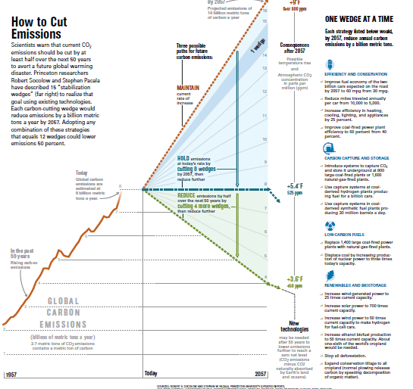

Slide 3
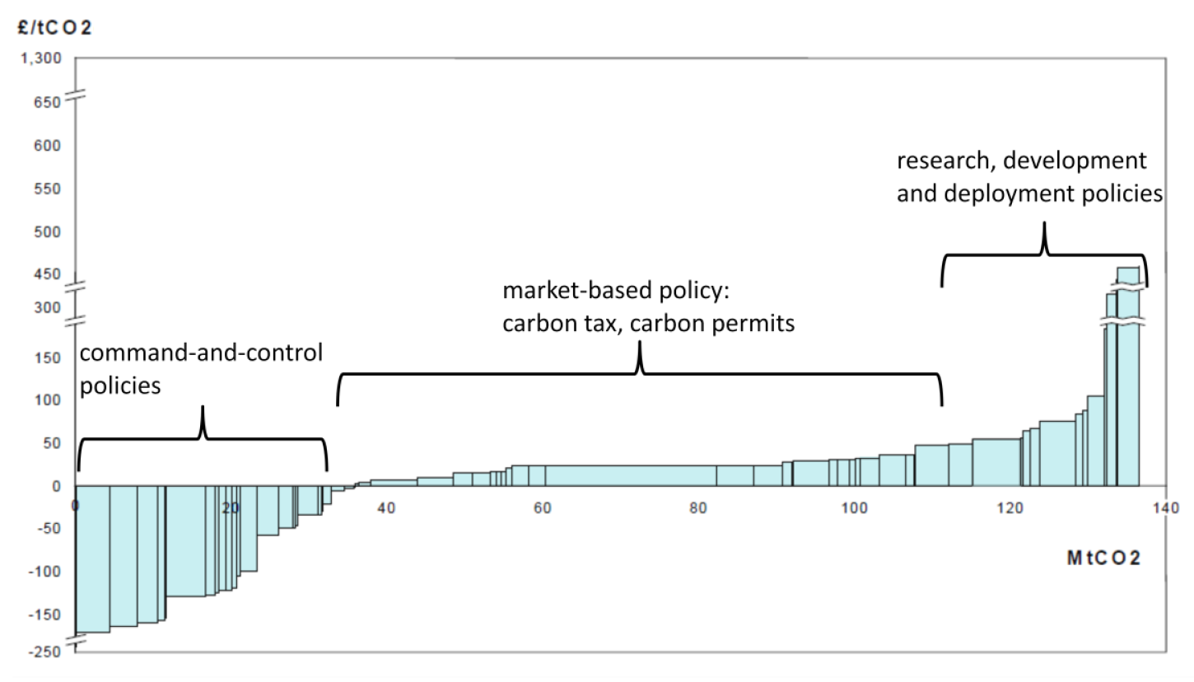
The use of MACC curves to define policy instruments for low carbon growth

Slide 4
Energy Forecasting Framework and Emissions Consensus Tool (EFFECT)
Developed by the World Bank
Excel-based, engineering-style, bottom-up tool with some built-in optimization
A consensus-building tool, designed to be used by multiple stakeholders
Designed to facilitate a transparent sharing of data and assumptions

Slide 5
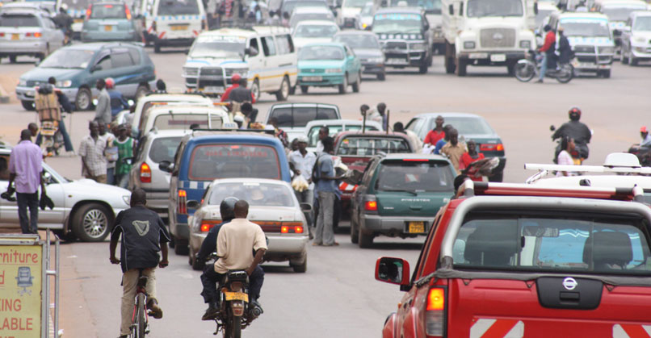


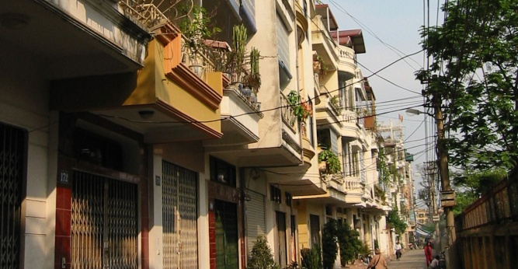
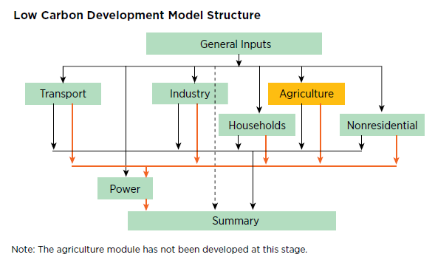
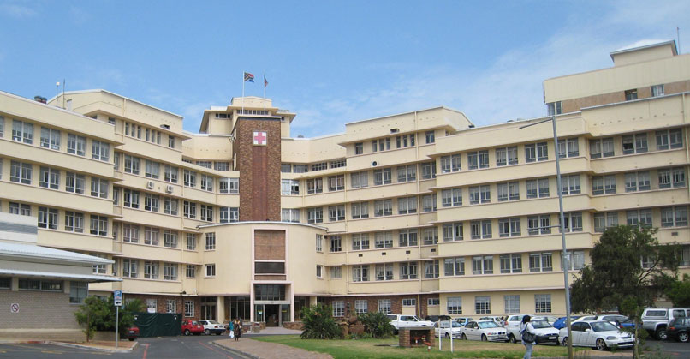
Current modules
Transport
Power
Industry
Households
Non-residential
Transport includes road, rail, waterborne, and air transportation of people and goods

Slide 6
EFFECT Ecosystem
The EFFECT Model
Freely downloadable from the World Bank (http://esmap.org/EFFECT)
Easily customizable to local requirements
e-Learning Courses
Extensive self-paced training course (https://olc.worldbank.org/content/low-carbon-development-planning-modelling-self-paced).
Over 2000 practitioners trained by the World Bank in facilitated courses

Slide 7
Usage
Power Sector
  India, Nigeria, Thailand, Philippines, Malaysia, Indonesia, Vietnam
Transport (on-road)
  10 city-level studies:
    Addis Ababa, Bangkok, Beijing, Chengdu, Guangzhou, Hanoi, Ho Chi Minh City, Jakarta, Manila, Ulaanbaatar
  Country-level Low Carbon Development studies:
    India, Brazil ,Poland, Georgia, Nigeria, Vietnam, Macedonia
    Malaysia, Indonesia, Thailand, Philippines
Household electricity
  India, Thailand, Philippines, Malaysia, Indonesia, Vietnam
Nonresidential and Industry
  India, Vietnam

Slide 8
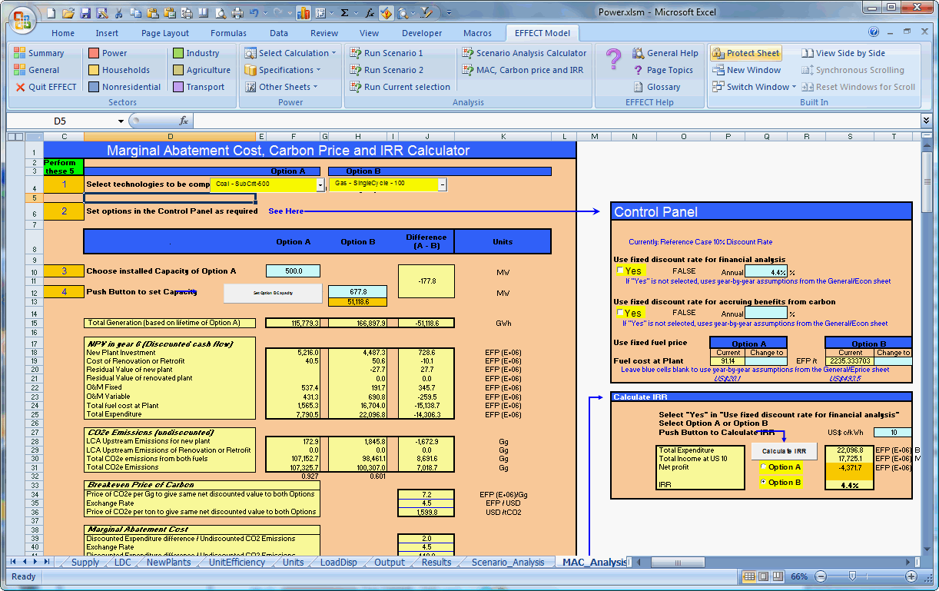
Ribbon navigation, analysis and help

Slide 9
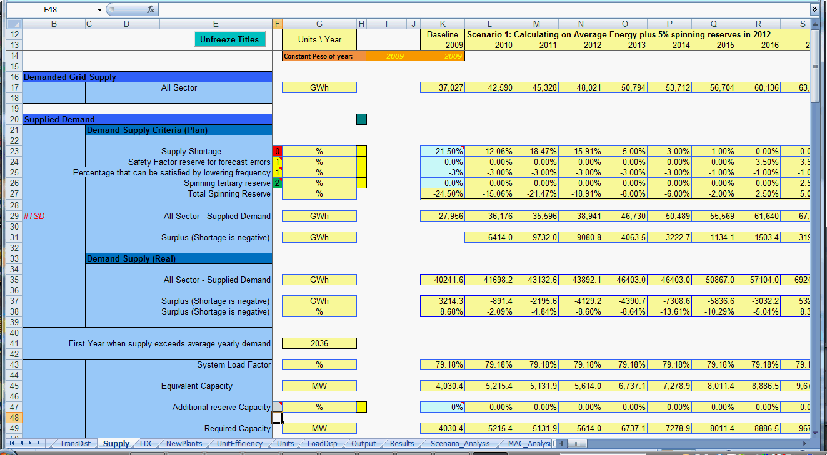
Easy to understand, adaptable, modifiable

Slide 10
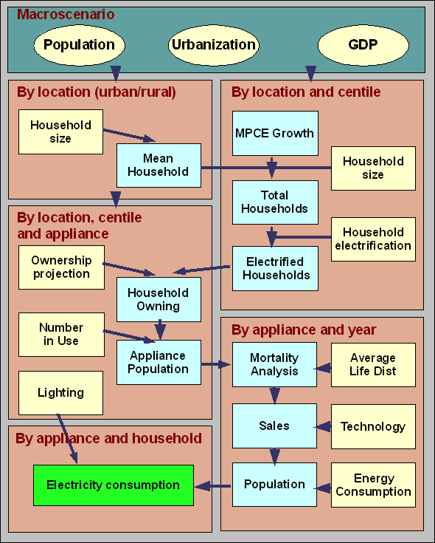
Household Module
Methodology
Uses Household (HH) Consumption Survey data to separate HH by location (Rural, Urban) into 100 quantiles each, ordered by per-capita income
Projects HH size, expenditure, and number of households per quantile from census and survey data to 2050
Forecasts electrified households
Analyzes ownership and use of 17 appliance type categories by HH quantile
Applies an appliance stock model and new appliance forecasts to model changes in energy efficiency
Determines electricity consumption and marginal abatement costs

Slide 11
Distribution of household size, expenditure and number
Macro Scenario
GDP
Population
Urbanization
1. National household size
2. Household size projection by location
4. Per capita income projection
Projected fraction of
urban households
Mean urban household size
Rural-urban migration
Total population / year
Number of urban households / year
MPCE growth projections
Mean national household size
Number of rural household / year
Mean rural household size
Annual urban MPCE
/ centile
Annual rural MPCE
/ centile
Total number of households / year
Rural population
Historic development
5. Adjustment of household size
6. Projected household expenditure
3. Baseline centiles
Number of rural households / centile
Adjustment factor
Historic annual rate of ratio change
Historic 15-64 age-group population size
Mean monthly household expenditure (MMHE)
Monthly per capita expenditure (MPCE)
/ 100 quantiles (centiles)
Weighted mean rural household size
/ centile
Number of urban households / centile
Historic number of households
Weighted mean urban household size
/ centile
Household size distribution / centile
Number of households / centile
Notes:
The darker blue boxes are related to rural

Slide 12
Identification of electrified households
Macro Scenario
GDP
Population
Urbanization
I
I
Household size
projection
Per capita income projection
Rural-urban migration
Total population / year
MPCE growth projections
Mean national household size
Annual urban MPCE / centile
Annual rural MPCE / centile
Total number of households / year
1. Electrified households
Household electrification program
Predicted electrification rate
Number of electrified rural households / centile
Number of electrified urban households / centile
Notes:
The transparent boxes indicate previous steps

Slide 13
Appliance ownership and active population
Projected active population
2. Number of appliances in use
1. Appliance ownership
Growth in active population
Projected number of appliances / household
Total number of appliances in use
/ centile
Number of
appliance-owning rural households
/ centile
Number of
appliance-owning urban households
/ centile
Mortality calculations
Annual replacement
Total number of appliances in use
/ centile
II
I
New appliance sales volumes / year
Electrified households
Projected household expenditure
Household electrification program
Mean monthly household expenditure (MMHE)
Predicted electrification rate
Projected active appliance population / year
Number of electrified rural households / centile
Number of electrified urban households / centile

Slide 14
Electric consumption from households
III
Projected active population
1. Lighting
Growth in active population
Projected urban electricity consumption from lighting
Historic electricity consumption from lighting
Mortality calculations
Annual replacement
Projected rural electricity consumption from lighting
New appliance sales volumes / year
2. Electricity consumption
Predicted use of individual appliances
Total projected electricity consumption from households
Projected active appliance population / year
Energy efficiency levels

Slide 15
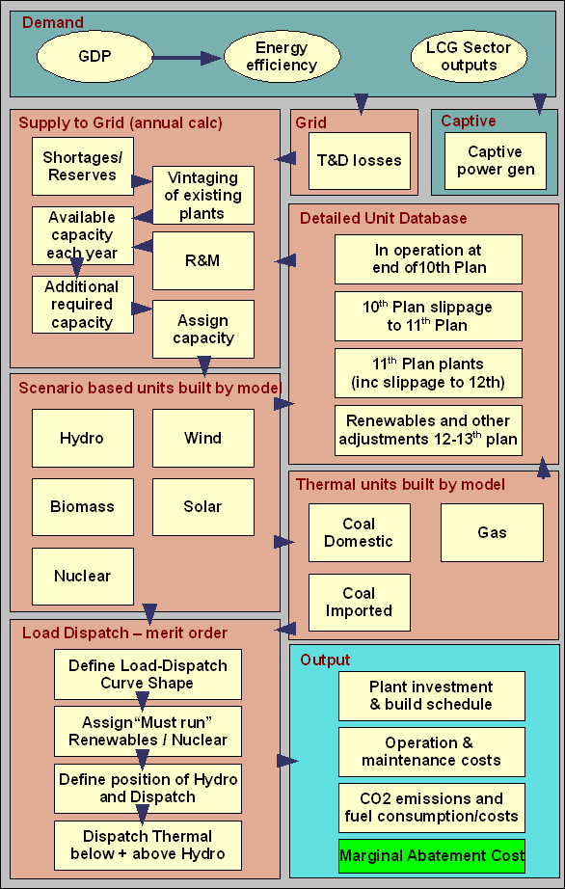
Power Sector Module
Methodology
Projects the demand for electricity to 2050 from sectoral analyses
Evaluates supply options from captive generation, T&D loss reduction and grid supply
Builds a detailed database of operating and planned generating units over the 40 year framework
Determines on a scenario basis, new generating units to be built by model to meet selected criteria. Model includes 67 on- and off-grid generating technologies
Analyzes best policy mix to make plant-build attractive to private investors
Conducts each year the load dispatch of available plants on a merit order low variable cost basis to cover demand
Calculates economic and financial outputs for each plant type by year and marginal abatement costs

Slide 16
Input
Power Module
Techno-Economic Modelling Framework
GDP
Urbanization
Population
Macro Scenario
Load Duration Curve
Household
Non-Residential
Industry
Transport
Demand
Transmission & Distribution
Supply
Load Dispatch Calculation
Scenario Analysis
Grid Demand
Supply needed
To be supplied to Grid
Current Capacity
Discount
Rate
Energy Efficiency
T & D Losses
Shortages
Additional Capacity
Each
Year
41 yrs
Investment Schedule
Captive Generation
Spinning Reserves
Plant Assignation
Plant Dispatch
Operating & Maintenance
GHG Emissions
Output
Off-grid power production on site
Assumed to use fuel oil for generators
New Plants
Units
Low Carbon Plants
Traditional Plants
Existing Plants
Planned Plants
Electricity Generation
Results
Notes:
The Energy Efficiency box does not go there. Grid demand is defined by user demand for electricity less off-grid or captive energy supply
Additional Capacity should be Required Additional Capacity
Mention load duration curves
In plant characteristics, capacity is important.
Why highlight Supply and System-wide per year?
Discount Rate should not be included (does not merit a box)

Slide 17
Currently includes 45 technologies plus an additional 22 off-grid technologies
…and easy to add more and modify
Coal
Diesel
Geothermal
Biomass/gas
Wind
Nuclear
Subcritical
300 MW
IGCC
500 MW
ICE
250 MW
Binary
20 MW
Landfill gas
5 MW
Onshore
100 MW
PHWR
1350 MW
Binary
300 MW
Binary
500 MW
Dual Flash
50 MW
Biomass MSW
20 MW
Offshore
100 MW
PWR
1200 MW
Supercritical
500 MW
IGCC + CCS
500 MW
Dual Flash
500 MW
Dual Flash
500 MW
Gas
Oil
Solar
Hydro
Ultracritical
500 MW
CFB Subcrit
300 MW
Dual Flash
500 MW
Dual Flash
50 MW
SingleCycle
150/250 MW
SingleCycle
150/250 MW
PV
5 MW
Storage
300 MW
Super + CCS
500 MW
CFB Supercrit
500 MW
Combined
450 - 800 MW
Combined
450 - 800 MW
Thermal
30 MW
Run-of-river
300 MW
SingleCycle
500 MW
SingleCycle
500 MW
Steam
500 MW
Steam
300 MW
Thermal-store
30 MW
Pumped
500 MW
Key
national
imported

Slide 18
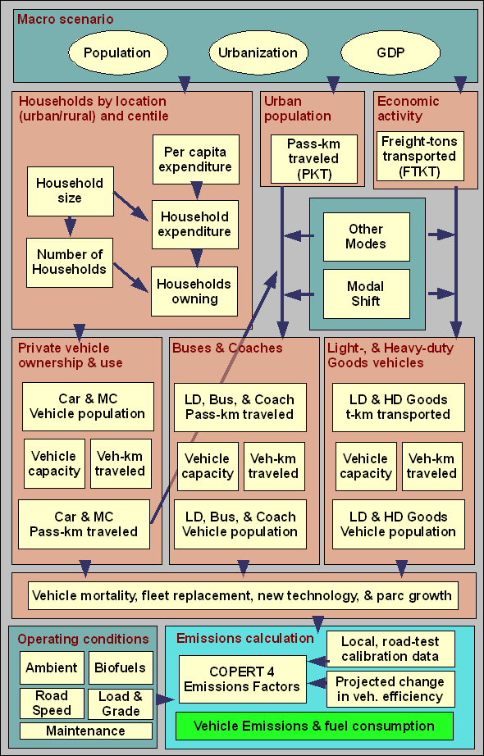
Transport Module
Methodology
Calculates and forecasts private vehicle ownership and use from HH survey data by location (Rural, Urban) in each of 100 quantiles, ordered by per-capita income
Evaluates passenger and freight commercial vehicle ownership and usage
Analyses other surface transport modes for passengers and freight (urban, suburban and long-distance rail; inland waterways and coastal shipping).
Evaluates modal shift in country-wide studies where traditional four-step transport model does not exist
Disaggregates vehicles into 250 emissions categories and applies advanced vehicle stock model and new technology forecasts to calculate: Fuel consumption, GHG and local emissions CO, VOC, NOx, PM
Calculates economic and financial outputs for each vehicle class by year and marginal abatement costs

Slide 19
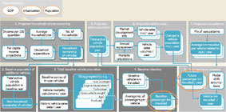
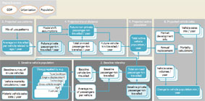
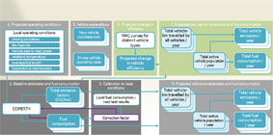
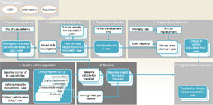
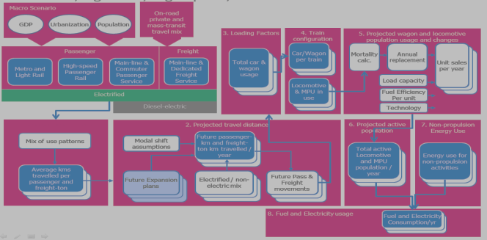
Transport
Modeling
Framework
Private vehicle ownership and use
On-road mass passenger transport
All vehicles
Efficiency and Emissions
On-road freight transport
Rail passenger and freight transport
Inland waterways and coastal
Aviation Passenger & Freight

Slide 20
Passenger cars and Two-wheelers
Private, commercial & governmental vehicle ownership & use
Macro Scenario
GDP
Urbanization
Population
1. Projected Urban/Rural household vehicle ownership
4. Projected active population
5. Projected population changes
6. Projected use patterns
Income per 100 quantiles
Average household size
No. of households
Market development info
Vehicle sales mix / year
Change to vehicle population mix / year
Mix of use patterns
Total active vehicle population / year
Annual replacement
Vehicle sales volumes / year
Average km travelled per vehicle related to age / year
Per capita income projections
Household expenditure
Household ownership of vehicles
Mortality calculations
2. Baseline population of additional vehicles
3. Total baseline vehicle population
7. Baseline ridership
8. Projected travel distance
Baseline survey of in-use vehicles
Disaggregated by e.g.
Baseline vehicle-km travelled
Future passenger-km travelled / year
Modal shift assump-tions
Total active vehicle population in baseline year
Type (subtype)
Engine displacement
Vehicle mortality calculations / year
Technology
Gross vehicle weight
Average no. of passengers per vehicle
Baseline passenger-km travelled
Age
Vehicle-km travelled / year
Non-household ownership of vehicles
Historic vehicle sales data / year
Fuel use
Notes:
In step 1: The darker framed boxes illustrates two sets of data (for rural and urban)
In steps 4-8: The underlying boxes illustrates that the projections are performed for the disaggregated population
In step 4 and 8: The orange circles indicates that this information is used in next steps for other passenger transport
For all: The inverted boxes indicates the ‘result’ of the given step

Slide 21
On-road mass passenger transport
Light duty commercial vehicles, busses and coaches
Macro Scenario
Private Vehicle Ownership& Use
GDP
Urbanization
Population
3. Projected use patterns
4. Projected travel distance
5. Projected active population
6. Projected population changes
Mix of use patterns
Modal shift assumptions
Future non-private passenger-km travelled / year
Vehicle sales mix / year
Market development info
Total active vehicle population / year
Average km travelled per vehicle related to age / year
Future private passenger-km travelled / year
Total on-road passenger-km travelled / year
Future vehicle-km travelled / year
Annual replacement
Mortality calculations
1. Baseline vehicle population
2. Baseline ridership
Baseline survey of in-use vehicles
Disaggregated by e.g.
Baseline vehicle-km travelled
Baseline passenger-km travelled
Total on-road passenger-km travelled
Vehicle sales volumes / year
Type (subtype)
Engine displacement
Vehicle mortality calculations / year
Technology
Gross vehicle weight
Average no. of passengers per vehicle
Baseline private passenger-km travelled
Age
Change to vehicle population mix / year
Historic vehicle sales data / year
Fuel use
Notes:
In step 2 and 4: The turquoise boxes indicates information taken from previous steps

Slide 22
On-road freight transport
Light, medium and heavy duty vehicles, trucks and tractor-trailers
Macro Scenario
GDP
Urbanization
Population
3. Projected use patterns
4. Projected travel distance
5. Projected vehicle sales mix
6. Projected vehicle population changes
Mix of use patterns
Future vehicle-km travelled / year
Mortality calc.
Annual replacement
Vehicle sales volumes / year
Change to freight vehicle population mix / year
Market development info
Average km travelled per vehicle related to age / year
Modal shift assumptions
Total on-road freight tonne-km travelled / year
Vehicle sales mix / year
Load capacity
Average load per vehicle
1. Baseline vehicle population
2. Baseline freight transported
7. Projected active population
Baseline survey of in-use vehicles
Disaggregated by e.g.
Baseline vehicle-km travelled
Baseline freight tonne-km travelled
Type (subtype)
Total active freight vehicle population / year
Engine displacement
Vehicle mortality calculations / year
Technology
Gross vehicle weight
Age
Average load per vehicle
Historic vehicle sales data / year
Fuel use

Slide 23
For all vehicles
Private vehicle ownership and use
On-road mass passenger transport
On-road freight transport
Efficiency and Emissions
1. Projected operating conditions
2. Vehicle expenditure
6. Projected change in efficiency
7. Projected low carbon emissions and fuel consumption
Local operating conditions
New vehicle purchase cost
Total vehicle-km travelled by all vehicles / year
Total vehicle emissions / year
MAC curves for distinct vehicle types
Driving conditions
Bio-fuel mix
Vehicle load & road grade
Ambient temperature
In-use vehicle operating costs
Projected change in vehicle efficiency
Total active vehicle population / year
Total fuel consumption / year
Average trip length
Inspection & maintenance
3. Baseline emissions and fuel consumption
4. Calibration to local conditions
5. Projected reference emissions and fuel consumption
Total emission factors
(CO2/km)
Total vehicle emissions / year
Local fuel consumption / road test results
Total vehicle-km travelled by all vehicles / year
COPERT4
Empirical data
Fuel consumption
Correction factor
Total fuel consumption / year
Total active vehicle population / year
Notes:
Step 1, 4 and 5: The mid-tone colour indicates that these contain projections also for the baseline year.
Step 6 and 7: The green colour indicates that this is performed for the low carbon scenario.

Slide 24
Currently includes:
250 vehicle types/technologies
28 Low Carbon technologies plus TDM & “soft” measures
…and easy to add more
2W:- Mopeds, scooters, and
motorcycles
3W :- All
PC :- Mini, Small, Lower Medium,
Medium and Upper Medium,
Large and Luxury, SUV
LCV :- AUV/MUV
Mini van/truck, pick-up, van
HCV :- Urban Bus by GVW range
Coach by GVW range
Rigid Truck by GVW range
Tractor-trailer by GCW range

Slide 25
Rail passenger and freight transport
Metro, Light Rail, High-speed, Suburban and Main-line Service
Macro Scenario
On-road private and mass-transit travel mix
GDP
Urbanization
Population
3. Loading Factors
4. Train
configuration
5. Projected wagon and locomotive population usage and changes
Passenger
Freight
Total car & wagon usage
Car/Wagon per train
Mortality calc.
Annual replacement
Unit sales per year
Metro and Light Rail
High-speed
Passenger Rail
Main-line & Commuter Passenger Service
Main-line & Dedicated Freight Service
Locomotive & MPU in use
Load capacity
Electrified
Fuel Efficiency
Per unit
Diesel-electric
Technology
1. Base-year use patterns
2. Projected travel distance
6. Projected active population
7. Non-propulsion Energy Use
Mix of use patterns
Modal shift assumptions
Future passenger-km and freight-ton km travelled / year
Total active Locomotive and MPU population / year
Energy use for non-propulsion activities
Average kms travelled per passenger and freight-ton
Future Expansion plans
Electrified / non-electric mix
Future Pass & Freight movements
8. Fuel and Electricity usage
Fuel and Electricity
Consumption/yr
Notes:
In step 2 and 4: The turquoise boxes indicates information taken from previous steps

Slide 26
Waterborne passenger and freight transport
Inland waterways and coastal shipping
Macro Scenario
On-road and rail private and mass-transit travel mix
GDP
Urbanization
Population
3. Loading Factors
4. Vessel / barge
configuration
5. Projected barge, vessel and tug population usage and changes
Total vessel loading and usage
TEU per unit and route type
Mortality calc.
Annual replacement
Unit sales per year
Freight
Passenger
Sea-going vessels
Self-propelled inland waterways
Push-barges inland waterways
Passenger Service
Load capacity
Propulsion units in use
Fuel Efficiency
Per unit
Technology
1. Base-year use patterns
2. Projected travel distance
6. Projected active population
7. Non-propulsion Energy Use
Mix of use patterns
Modal shift assumptions
Future passenger-km and TEU-km travelled / year
Total active vessel population / year
Energy use for non-propulsion activities
Average kms travelled per TEU and passenger
Future Expansion plans
Propulsion unit mix
Future Pass & Freight movements
8. Fuel usage
Fuel
Consumption/yr
Notes:
In step 2 and 4: The turquoise boxes indicates information taken from previous steps

Slide 27
Civil Aviation
National Passenger & Freight, International Passenger & Freight
Macro Scenario
On-road, water and rail private and mass-transit travel mix
GDP
Urbanization
Population
4. Loading Factors
5. Projected Aircraft population usage and operation
6. Economics
Aircraft loading and usage
Mortality calc.
Annual replacement
Unit sales per year
CAPEX, OPEX, Maintenance
Fuel Personnel
1. Representative sample of scheduled flights in recent year
National
Passenger
National
Freight
International
Passenger
International
Freight
Load capacity
Fuel Efficiency
Per unit
Technology
2. Base-year use patterns
3. Projected travel distance
7. Projected active population
8. Emissions and Energy Calculation
Mix of use patterns
Modal shift assumptions
Future passenger-km and freight ton-km travelled / year
Total active vessel population / year
EMEP / EEA
Emissions
model
LTO and CCD distances by aircraft type
Future Expansion plans
Aircraft mix
Future Pass & Freight movements
9. Fuel usage and emissions
CO2 emissions
NOx emissions
SOx
emissions
CO emissions
HC emissions
PM emissions
Fuel
Consumption/yr
Notes:
In step 2 and 4: The turquoise boxes indicates information taken from previous steps

Slide 28
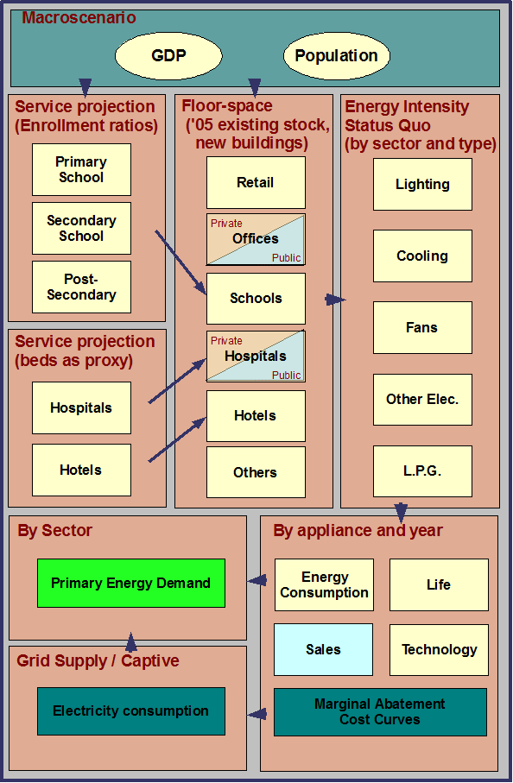
Nonresidential Module
Methodology
Projects the change in activity in each sector, sub-sector and the corresponding increase in floor-space required to 2050
Determines the current energy intensity for each sector and sub-sector
Identifies applicable efficiency measures and new technology
Analyzes best policy mix to make investment attractive to private investors
Computes energy consumption and electricity supply sources
Calculates economic and financial outputs for each sector and sub-sector by year and marginal abatement costs

Slide 29
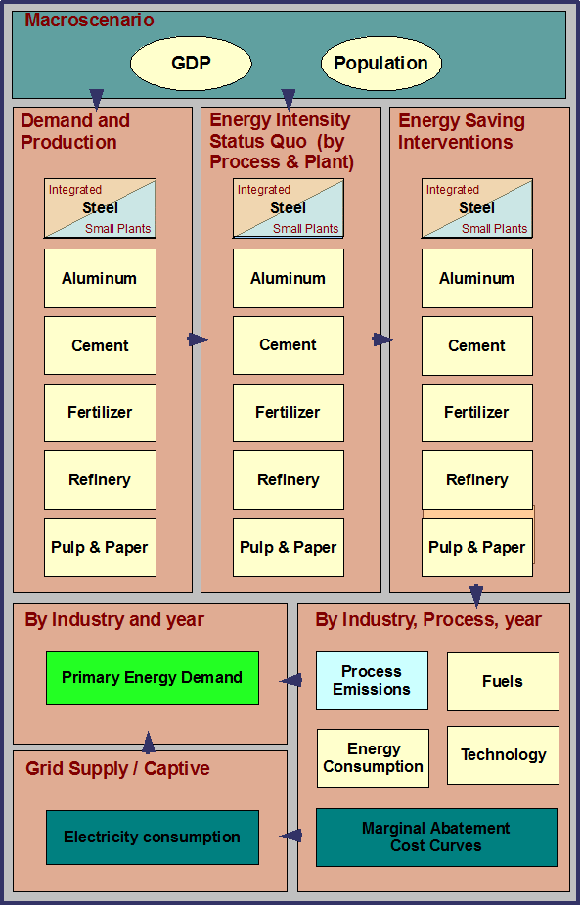
Industry Module
Methodology
Develops a demand model for each industry based on national consumption, imports and exports to 2050
Evaluates the needed mix of new and existing plants
Determines the processes used and intermediate products and estimates the current energy intensity and process emissions
Identifies applicable efficiency measures, technologies and process improvements
Analyzes best policy mix to make new plant build and efficiency measures attractive to private investors
Computes energy consumption, process emissions and electricity supply sources
Calculates economic and financial outputs for each sector and sub-sector by year and marginal abatement costs

Slide 30
Thank You
jarogers@worldbank.org

